Slide 1
Revolution Robotics
Brain (BRbeta) assembly instructions

Slide 2
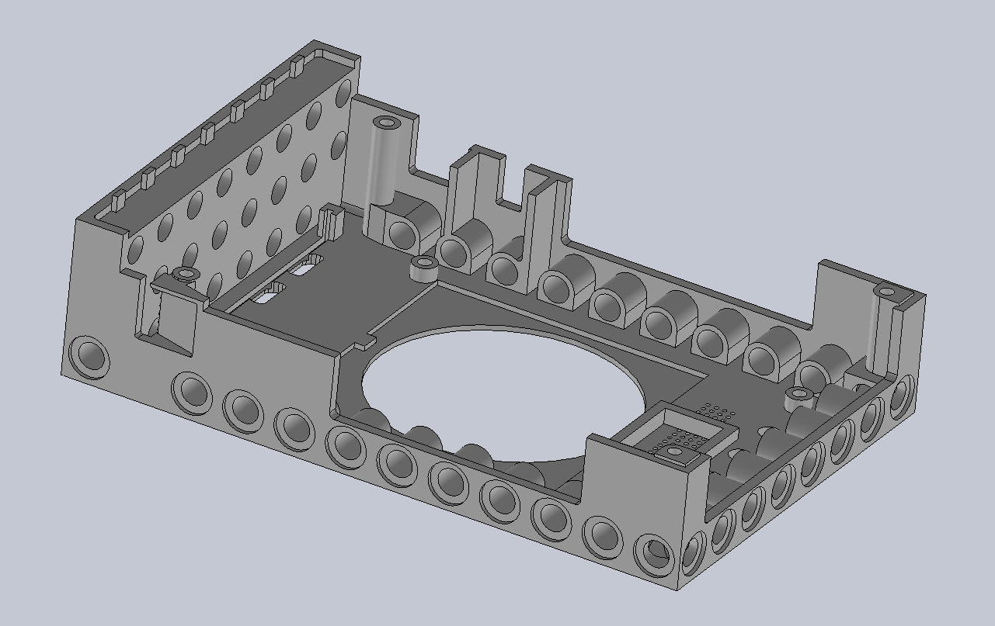
Step 1: Start with top cover (BRcA_1)

Slide 3
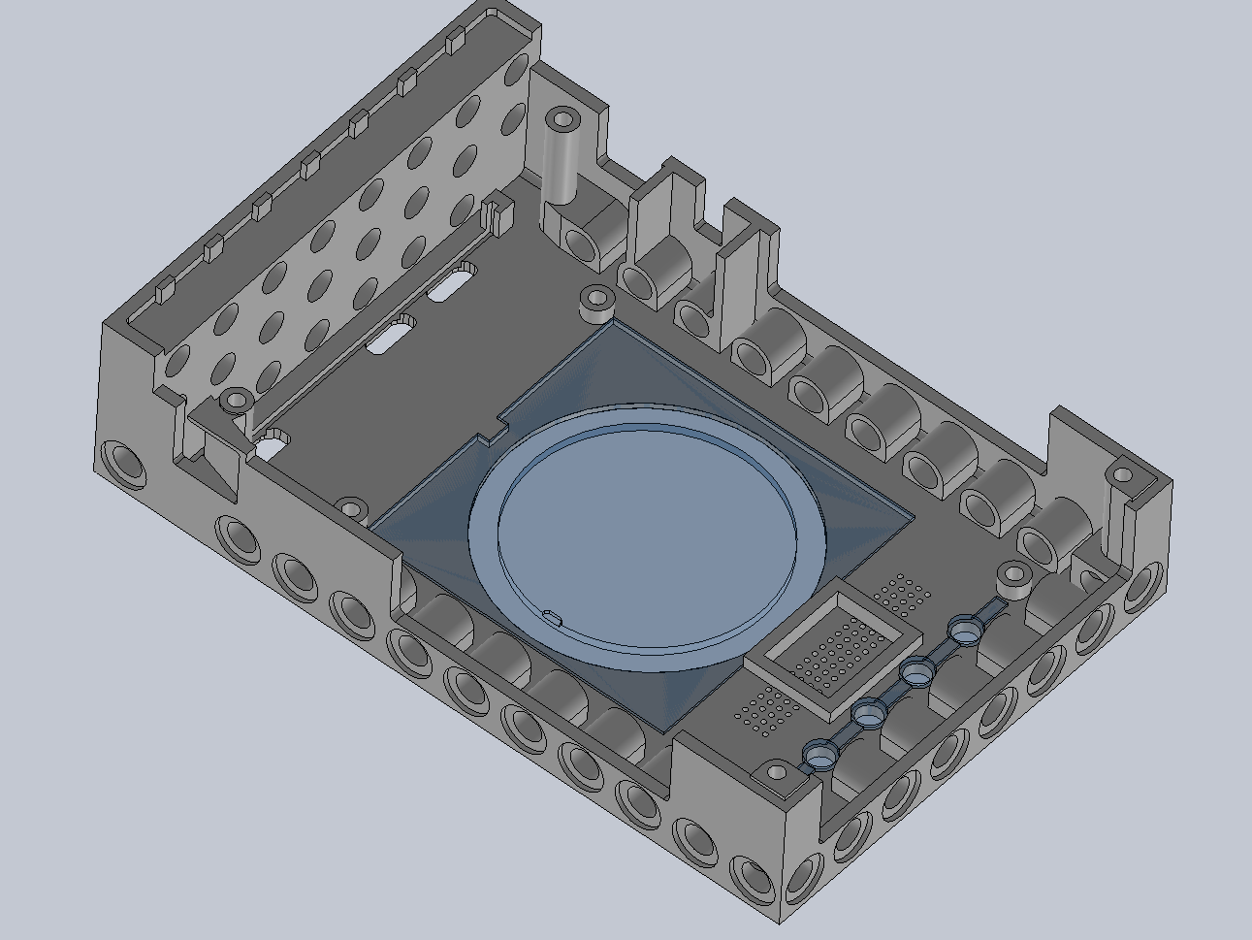
Step 2: Attach transparent ring (BRcA_4) and light pipes (BRcA_5)

Slide 4
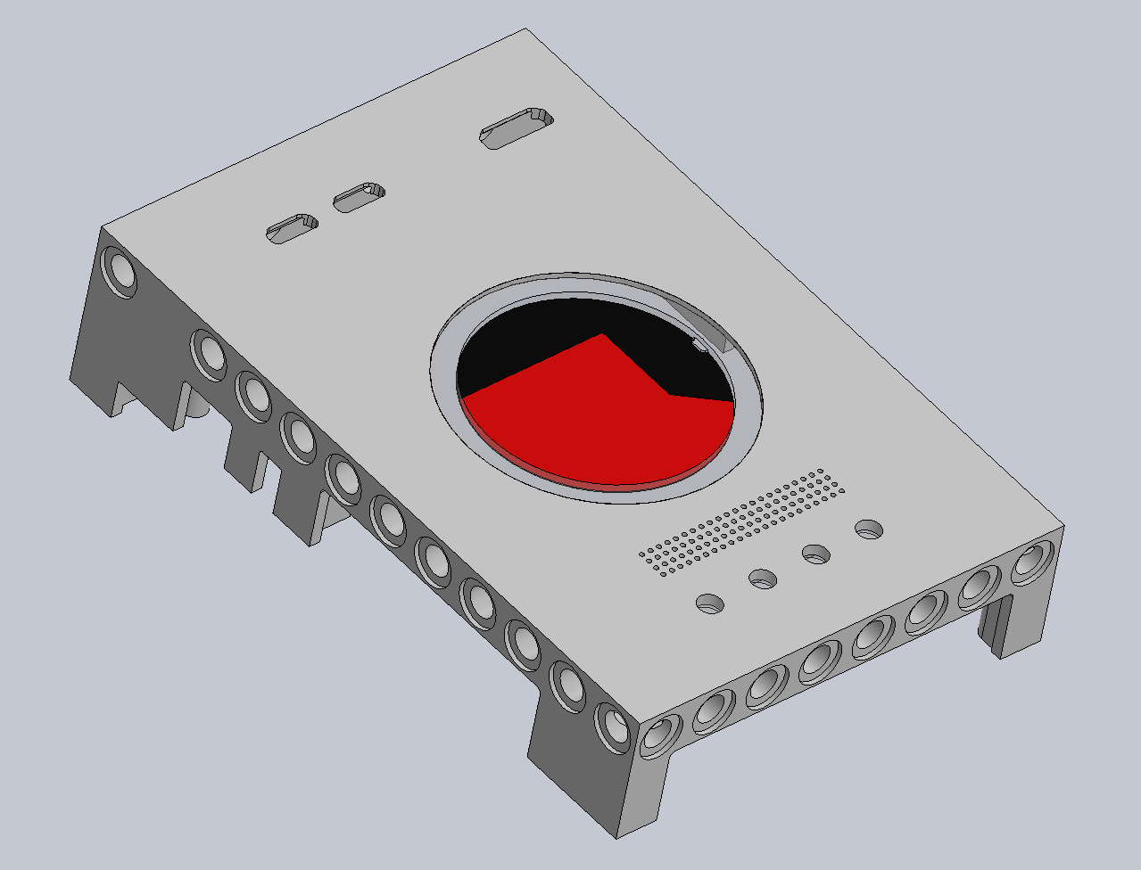
Step 3: Insert red-black sticker

Slide 5
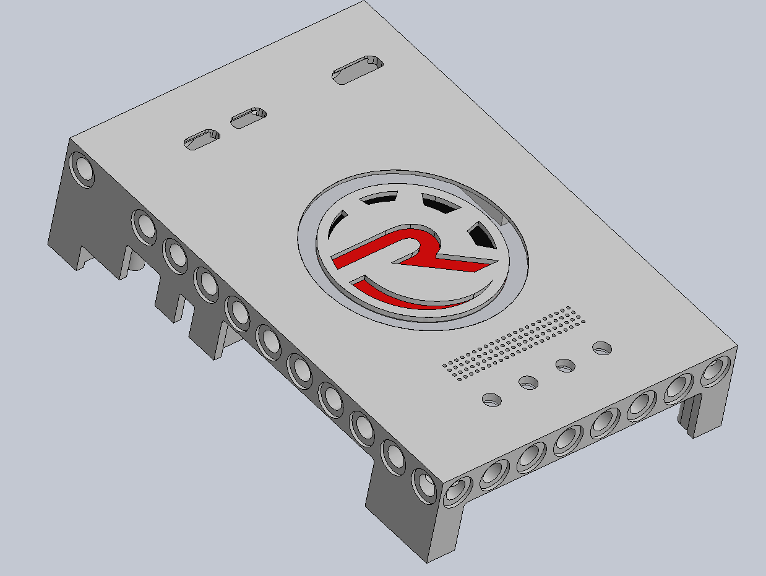
Step 4: Add logo part (BRcA_3)

Slide 6
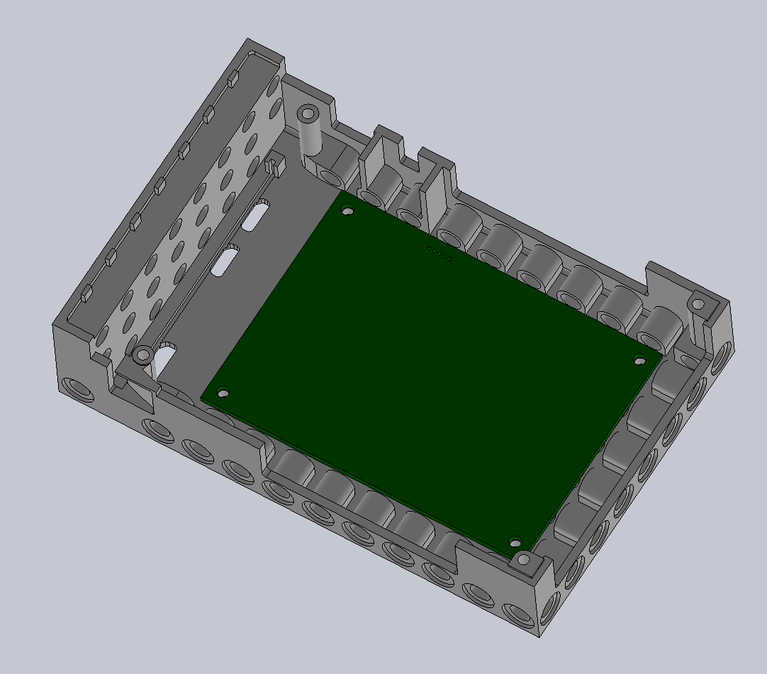
Step 5: Insert LED board

Slide 7
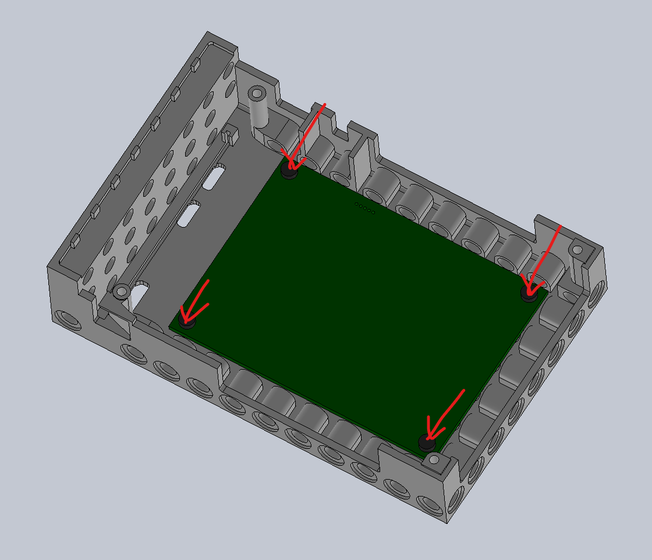
Step 6: Screw LED board

Slide 8
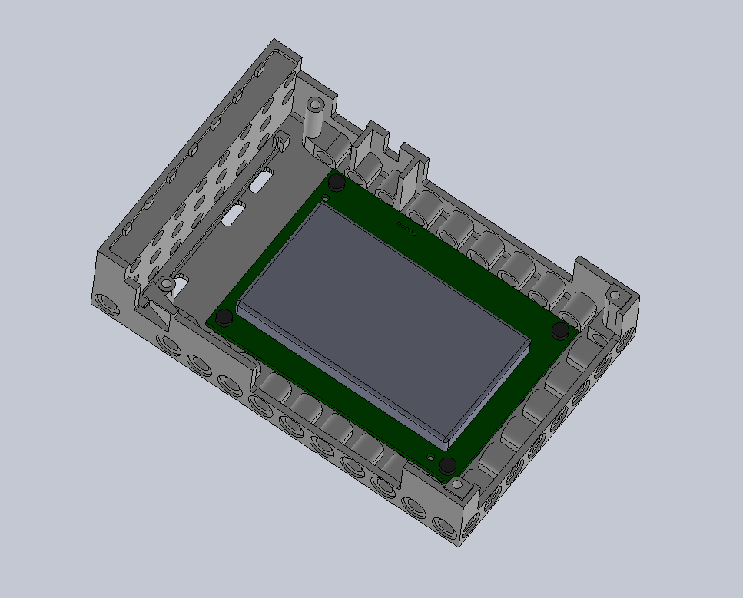
Step 7: Use adhesive tape to attach battery to LED board

Slide 9
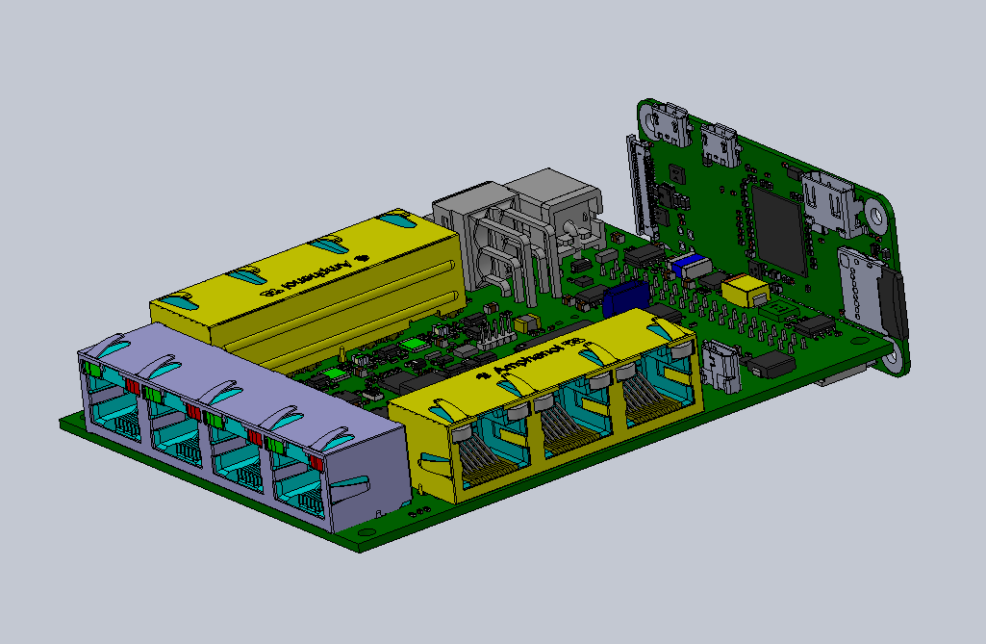
Step 8: Assemble carrier board with Raspberry Pi Zero W

Slide 10
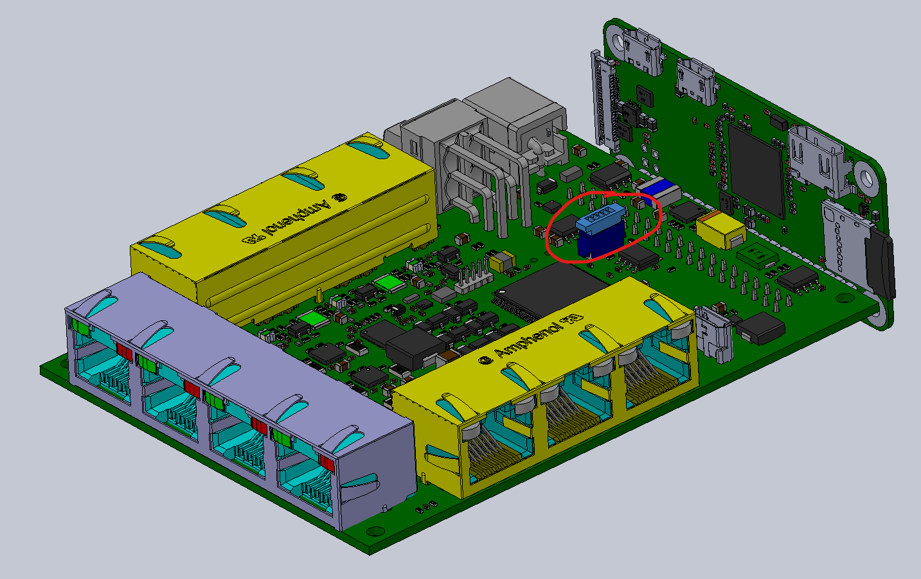
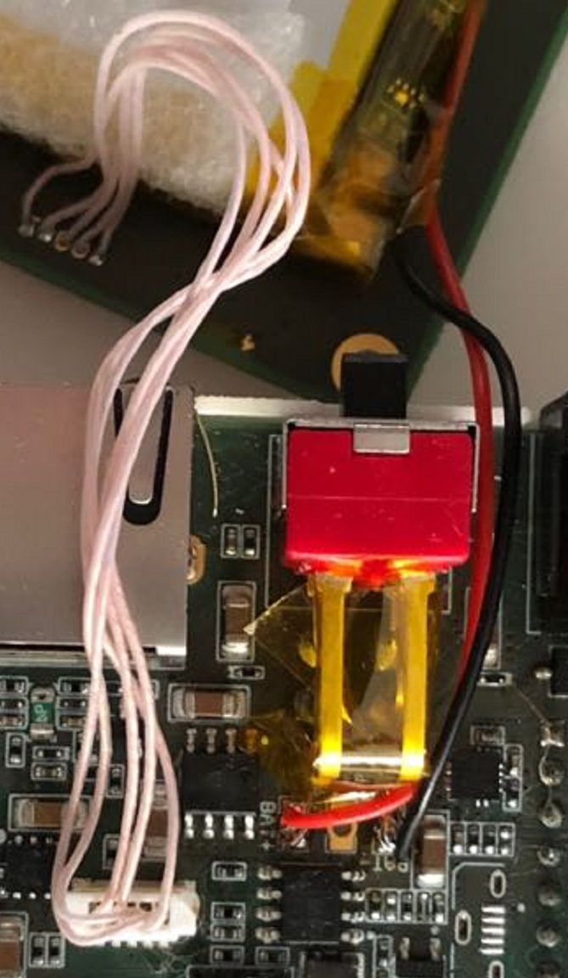
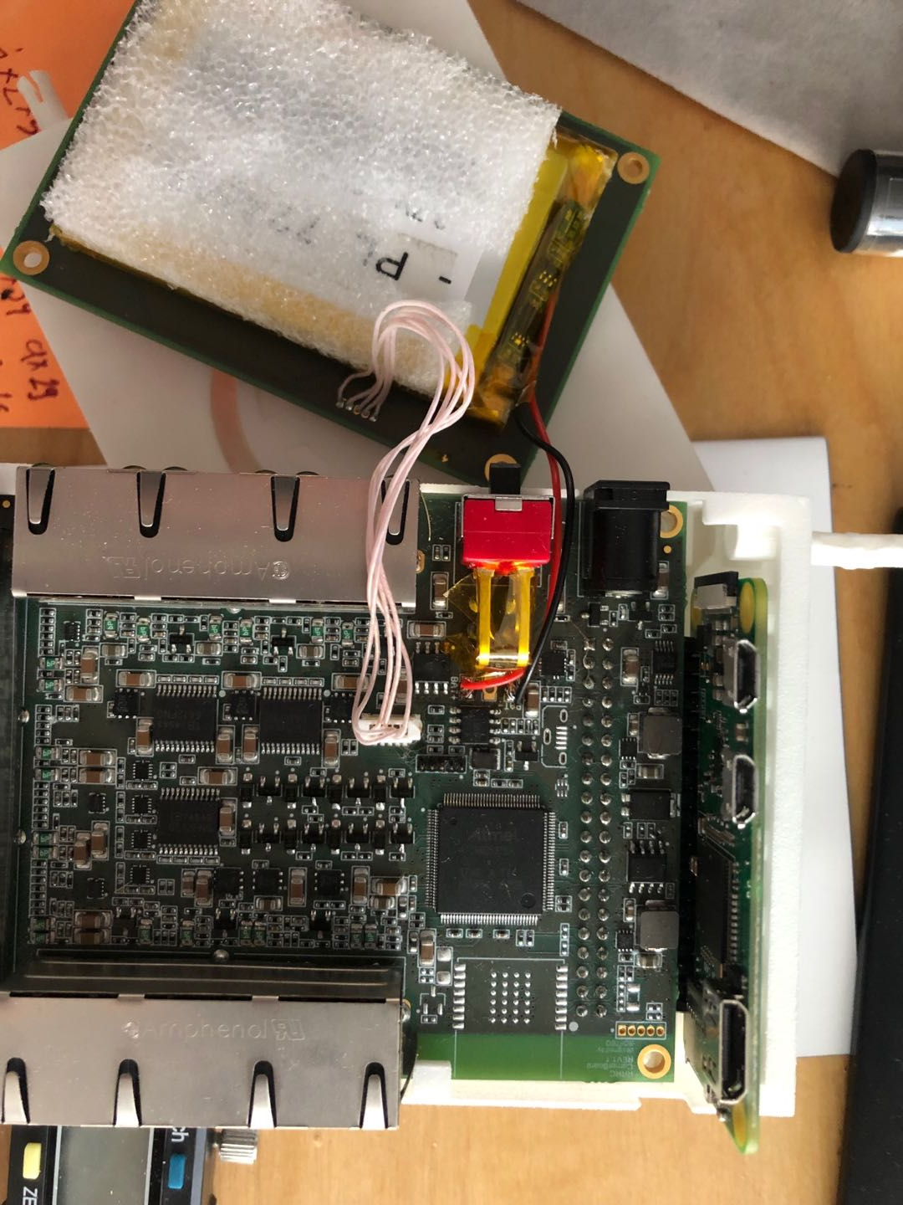
Step 9: Connect LED board and battery wires

Slide 11
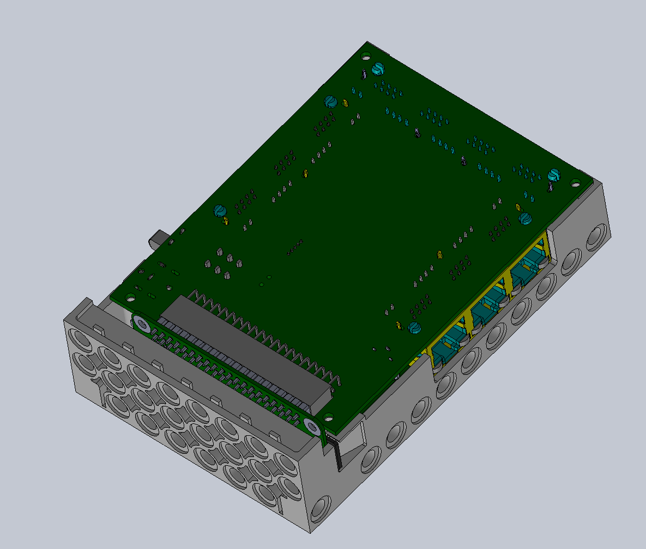
Step 10: Insert carrier board to top cover

Slide 12
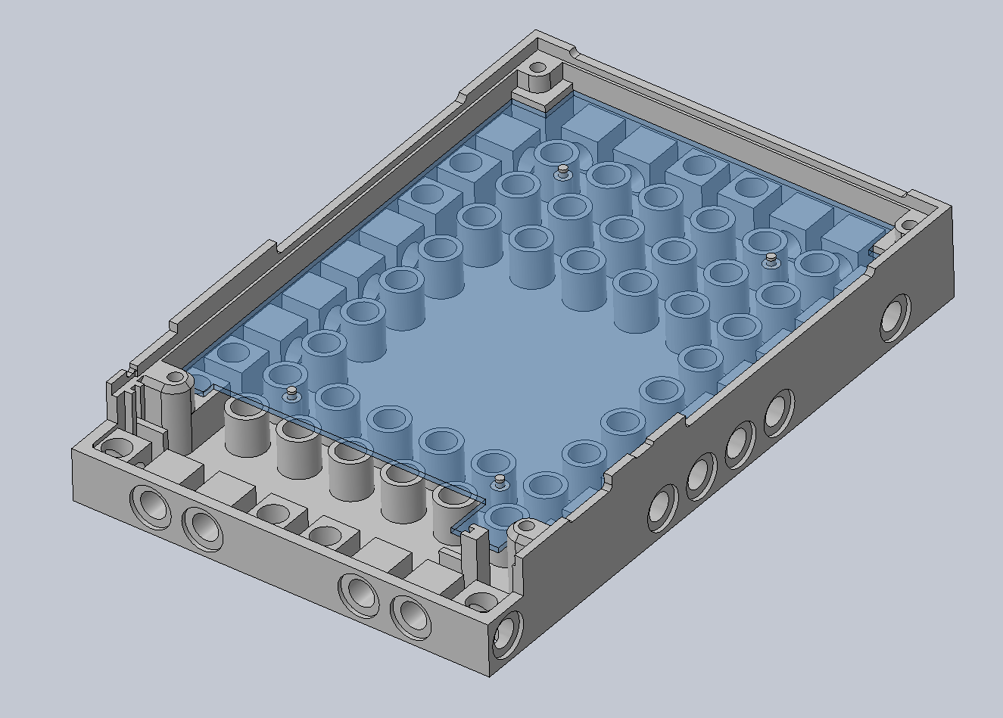
Step 11: Add plastic sheet (BRcA_6) to bottom cover (BRcA_2)

Slide 13
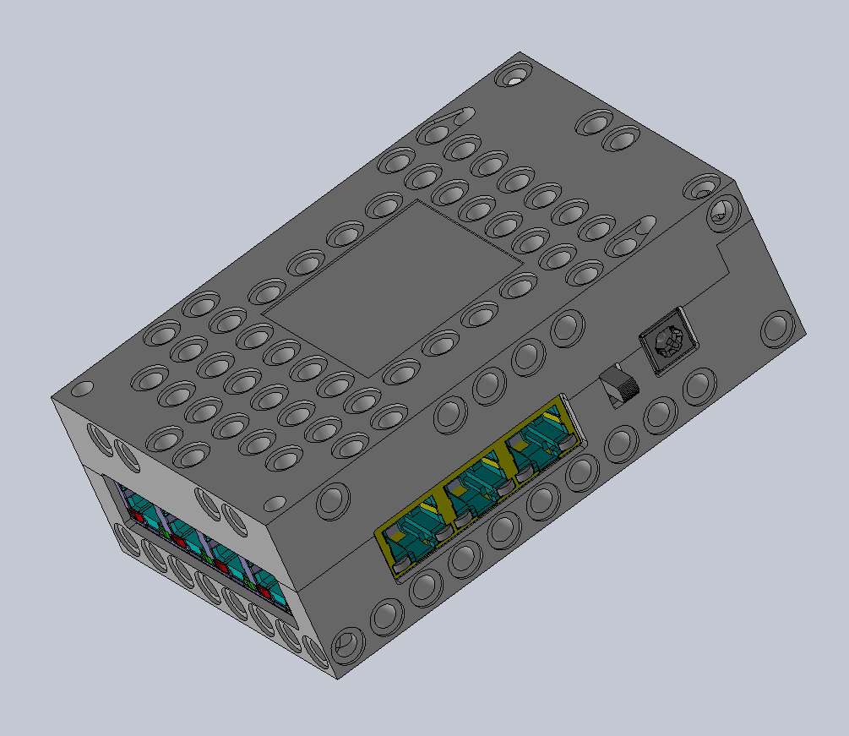
Step 12: Attach bottom cover to top cover

Slide 14
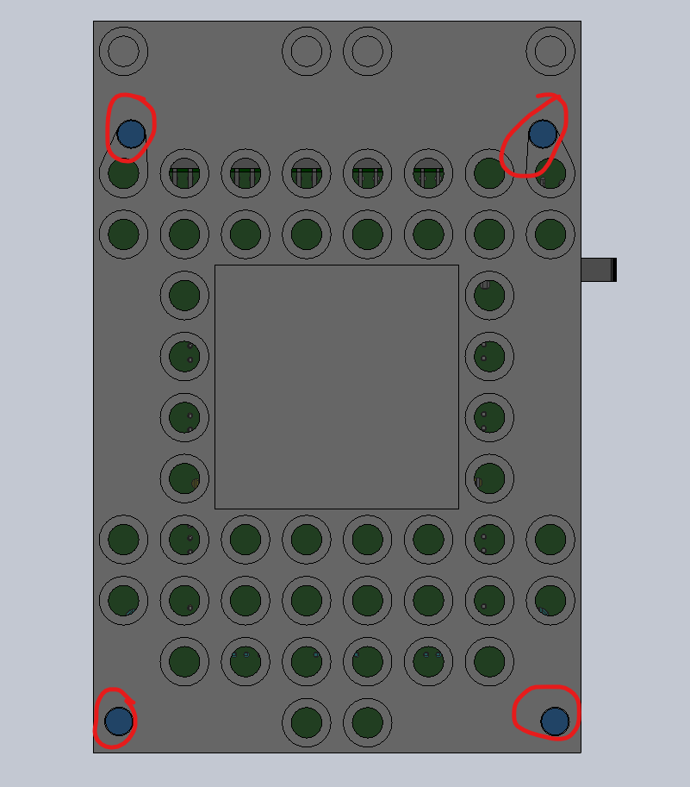
Step 13: Screw bottom part to top cover

